Slide 1
Error Information

Slide 2
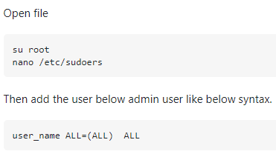
Sudoers issue
Su root_user
Sudo nano /etc/sudoers
User_name ALL=(ALL) ALL

Slide 3
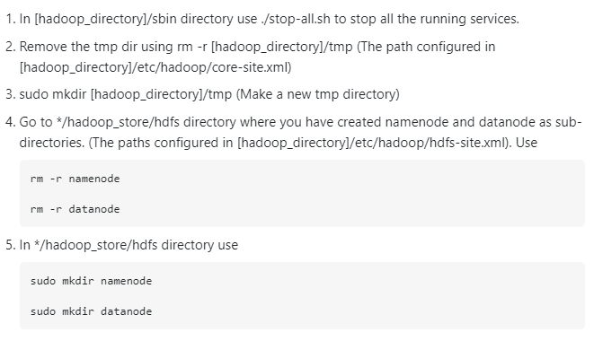
Datanode missing on jps

Slide 4
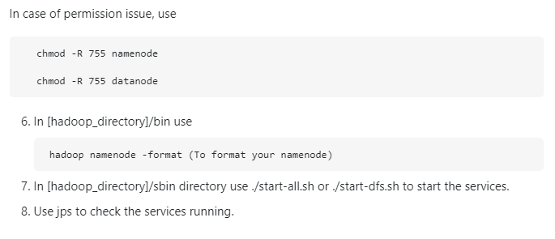

Slide 5
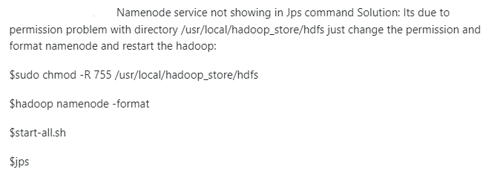
Permission error
Sudo chmod -755 /home/hadoop/dfsdata

